Slide 1
Sets
A
B
C

Slide 2
This Lecture
We will first introduce some basic set theory before we do counting.
Basic Definitions
Operations on Sets
Set Identities
Russell’s Paradox

Slide 3
Defining Sets
Definition: A set is an unordered collection of objects.
The objects in a set are called the elements or members
of the set S, and we say S contains its elements.
We can define a set by directly listing all its elements.
e.g. S = {2, 3, 5, 7, 11, 13, 17, 19},
S = {CS1130, CS2110, MS2020, SS2510}
After we define a set, the set is a single mathematical object,
and it can be an element of another set.
e.g. S = {{1,2}, {1,3}, {1,4}, {2,3}, {2,4}, {3,4}}

Slide 4

Defining Sets by Properties
It is inconvenient, and sometimes impossible,
to define a set by listing all its elements.
Alternatively, we can define by a set by describing
the properties that its elements should satisfy.
We use the notation
to define the set as the set of elements, x,
in A such that x satisfies property P.
e.g.

Slide 5



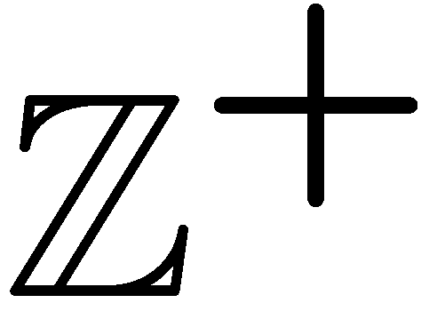
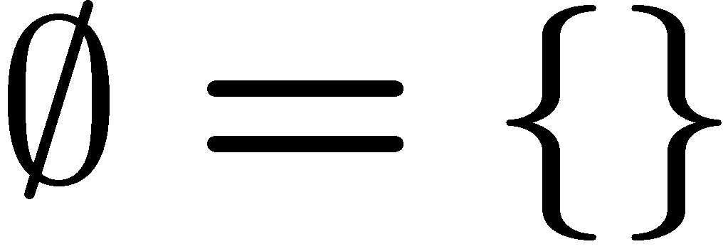
Examples of Sets
Well known sets:
the set of all real numbers,
the set of all complex numbers,
the set of all integers,
the set of all positive integers
empty set, , the set with no elements.
Other examples:
The set of all polynomials with degree at most three: {1, x, x², x³, 2x+3x²,…}.
The set of all n-bit strings: {000…0, 000…1, …, 111…1}
The set of all triangles without an obtuse angle: { , ,… }
The set of all graphs with four nodes: { , , , ,…}

Slide 6

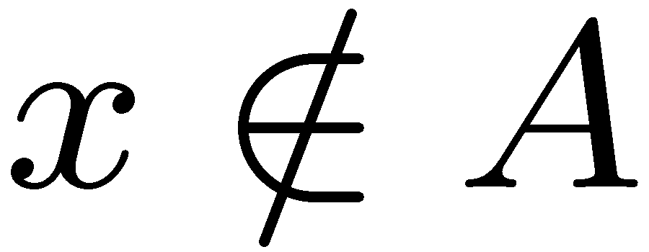

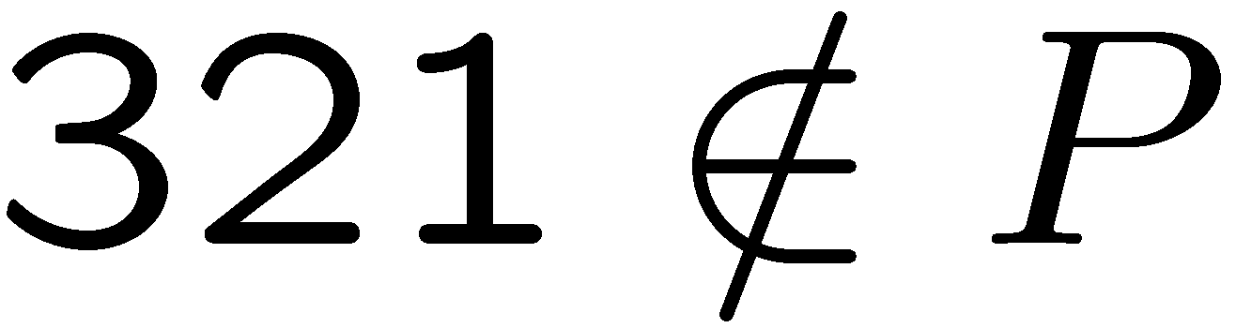

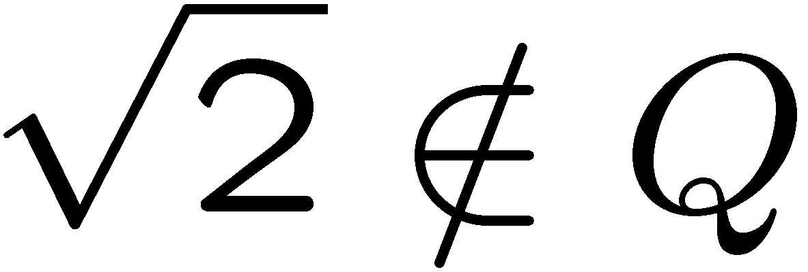
Membership
Order, number of occurence are not important.
e.g. {a,b,c} = {c,b,a} = {a,a,b,c,b}
The most basic question in set theory is whether an element is in a set.
x is an element of A
x is in A
x is not an element of A
x is not in A
Recall that Z is the set of all integers. So and .
Let P be the set of all prime numbers. Then and
Let Q be the set of all rational numbers. Then and
e.g.
7 
2/3  
(will prove later)

Slide 7
Size of a Set
In this course we mostly focus on finite sets.
Definition: The size of a set S, denoted by |S|,
is defined as the number of elements contained in S.
e.g. if S = {2, 3, 5, 7, 11, 13, 17, 19}, then |S|=8.
if S = {CS1130, CS2110, MS2020, SS2510}, then |S|=4.
if S = {{1,2}, {1,3}, {1,4}, {2,3}, {2,4}, {3,4}}, then |S|=6.
Later we will study how to determine the size of the following sets:
  the set of poker hands which are “full house”.
  the set of n-bit strings without three consecutive ones.
  the set of valid ways to add n pairs of parentheses

Slide 8



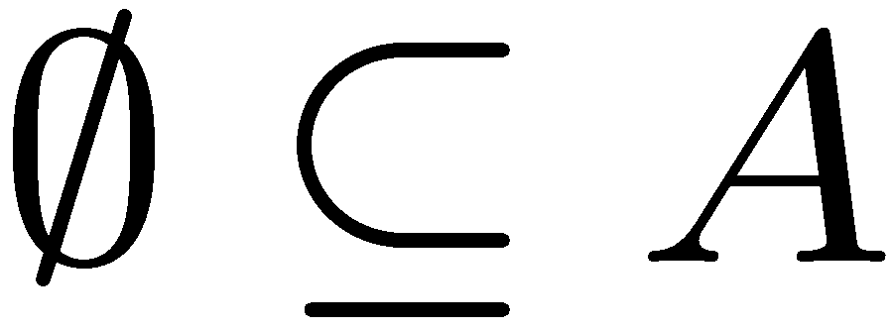

Subset
Definition: Given two sets A and B, we say A is a subset of B,
denoted by , if every element of A is also an element of B.
A
B
not a subset
If A={4, 8, 12, 16} and B={2, 4, 6, 8, 10, 12, 14, 16}, then but
because every element in A is an element of A.
for any A because the empty set has no elements.
If A is the set of prime numbers and B is the set of odd numbers, then
Fact: If , then |A| <= |B|.

Slide 9


Proper Subset, Equality
Definition: Given two sets A and B, we say A is a proper subset of B,
denoted by , if every element of A is an element of B,
But there is an element in B that is not contained in A.
A
B
Fact: If , then |A| < |B|.
Definition: Given two sets A and B, we say A = B if and .
A
B
Fact: If A = B, then |A| = |B|.

Slide 10




Exercises
?
{3} {5,7,3}?
 every set?
{1,2} {{1,2}, {2,3}, {3,1}}?
{a} = {{a}}?
If A B and B C, then A C?
If A B and B C, then A C?

Slide 11
This Lecture
Basic Definitions
Operations on Sets
Set Identities
Russell’s Paradox

Slide 12
Basic Operations on Sets
Let A, B be two subsets of a universal set U
(depending on the context U could be R, Z, or other sets).
intersection:
Defintion: Two sets are said to be disjoint if
their intersection is an empty set.
e.g. Let A be the set of odd numbers, and B be the set of even numbers.
Then A and B are disjoint.
union:
Fact:

Slide 13

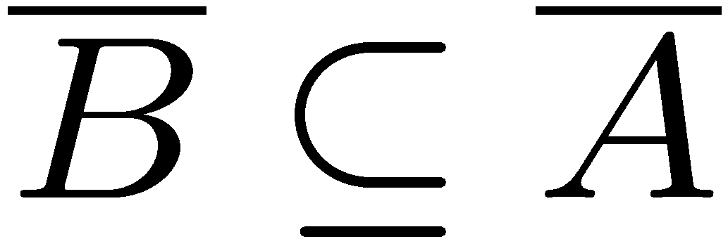
Basic Operations on Sets
difference:
Fact:
complement:
e.g. Let U = Z and A be the set of odd numbers.
Then is the set of even numbers.
Fact: If , then

Slide 14


Examples
A = {1, 3, 6, 8, 10} B = {2, 4, 6, 7, 10}
A B = {6, 10}, A B = {1, 2, 3, 4, 6, 7, 8, 10} A-B = {1, 3, 8}
Let U = { x Z | 1 <= x <= 100}.
A = { x U | x is divisible by 3}, B = { x U | x is divisible by 5}
A B = { x U | x is divisible by 15}
A B = { x U | x is divisible by 3 or is divisible by 5 (or both)}
A – B = { x U | x is divisible by 3 but is not divisible by 5 }
Exercise: compute |A|, |B|, |A B|, |A B|, |A – B|.

Slide 15
Partitions of Sets
Two sets are disjoint if their intersection is empty.
A collection of nonempty sets {A₁, A₂, …, A_{n}} is a partition of a set A
if and only if
A₁, A₂, …, A_{n} are mutually disjoint (or pairwise disjoint).
e.g. Let A be the set of integers.
A₁ = {x A | x = 3k+1 for some integer k}
A₂ = {x A | x = 3k+2 for some integer k}
A₃ = {x A | x = 3k for some integer k}
Then {A₁, A₂, A₃} is a partition of A

Slide 16
Partitions of Sets
e.g. Let A be the set of integers divisible by 6.
A₁ be the set of integers divisible by 2.
A₂ be the set of integers divisible by 3.
Then {A₁, A₂} is not a partition of A, because A₁ and A₂ are not disjoint,
and also A A₁ A₂ (so both conditions are not satisfied).
e.g. Let A be the set of integers.
Let A₁ be the set of negative integers.
Let A₂ be the set of positive integers.
Then {A₁, A₂} is not a partition of A, because A ≠A₁ A₂
as 0 is contained in A but not contained in A₁ A₂

Slide 17
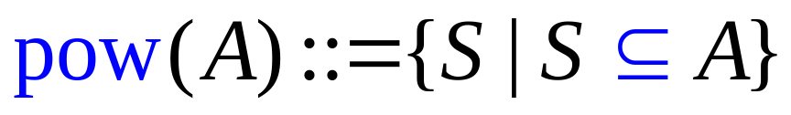
Power Sets
power set:
In words, the power set pow(A) of a set A
contains all the subsets of A as members.
pow({a,b}) = {, {a}, {b}, {a,b}}
pow({a,b,c}) = {, {a}, {b}, {c}, {a,b}, {a,c}, {b,c}, {a,b,c}}
pow({a,b,c,d}) = {, {a}, {b}, {c}, {d},
{a,b}, {a,c}, {b,c}, {a,d}, {b,d}, {c,d},
{a,b,c}, {a,b,d}, {a,c,d}, {b,c,d}, {a,b,c,d}}
Fact (to be explained later): If A has n elements, then pow(A) has 2^{n} elements.

Slide 18
Cartesian Products
Definition: Given two sets A and B, the Cartesian product A x B is the
set of all ordered pairs (a,b), where a is in A and b is in B. Formally,
Ordered pairs means the ordering is important, e.g. (1,2) ≠ (2,1)
e.g. Let A be the set of letters, i.e. {a,b,c,…,x,y,z}.
Let B be the set of digits, i.e. {0,1,…,9}.
AxA is just the set of strings with two letters.
BxB is just the set of strings with two digits.
AxB is the set of strings where the first character is a letter
and the second character is a digit.

Slide 19
Cartesian Products
The definition can be generalized to any number of sets, e.g.
Using the above examples, AxAxA is the set of strings with three letters.
Our ID card number has one letter and then six digits,
so the set of ID card numbers is the set AxBxBxBxBxBxB.
Fact: If |A| = n and |B| = m, then |AxB| = nm.
Fact: If |A| = n and |B| = m and |C| = l, then |AxBxC| = nml.
Fact: |A₁xA₂x…xA_{k}| = |A₁|x|A₂|x…x|A_{k}|.

Slide 20
Exercises
Let A be the set of prime numbers, and let B be the set of even numbers.
What is A B and |A B|?
2. Is |A B| > |A| > |A B| always true?
3. Let A be the set of all n-bit binary strings, A_{i} be the set of all n-bit
binary strings with i ones. Is (A₁, A₂, …, A_{i}, …, A_{n}) a partition of A?
4. Why the name Cartesian product?
5. Let A = {x,y}. What is pow(A)xpow(A) and |pow(A)xpow(A)|?

Slide 21
This Lecture
Basic Definitions
Operations on Sets
Set Identities
Russell’s Paradox

Slide 22


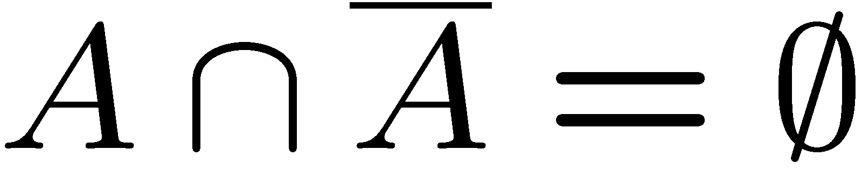

Set Identities
Some basic properties of sets, which are true for all sets.

Slide 23
Set Identities
Distributive Law:
(1)
(2)
A
B
A
B
C
C
(1)
(2)

Slide 24
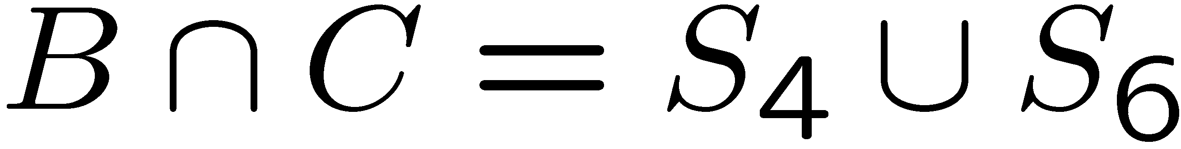
Set Identities
Distributive Law:
We can also verify this law more carefully
L.H.S
S₁
S₂
A
S₃
B
S₄
S₅
S₆
R.H.S.
S₇
C
There are formal proofs in the textbook, but we don’t do that.

Slide 25



Set Identities
De Morgan’s Law:

Slide 26

Set Identities
De Morgan’s Law:

Slide 27
Disproof
A
B
A
B
C
C
L.H.S
R.H.S

Slide 28
Disproof
1
2
3
1
2
3
A
B
A
B
5
4
5
6
4
6
7
7
C
C
We can easily construct a counterexample to the equality,
by putting a number in each region in the figure.
Let A = {1,2,4,5}, B = {2,3,5,6}, C = {4,5,6,7}.
Then we see that L.H.S = {1,2,3,4} and R.H.S = {1,2}.

Slide 29
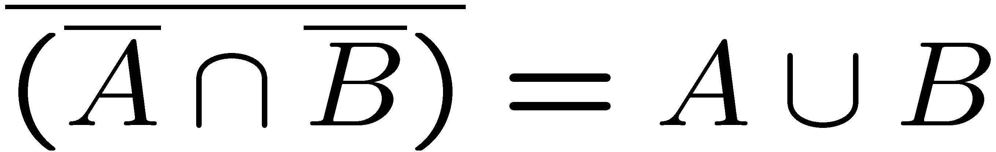
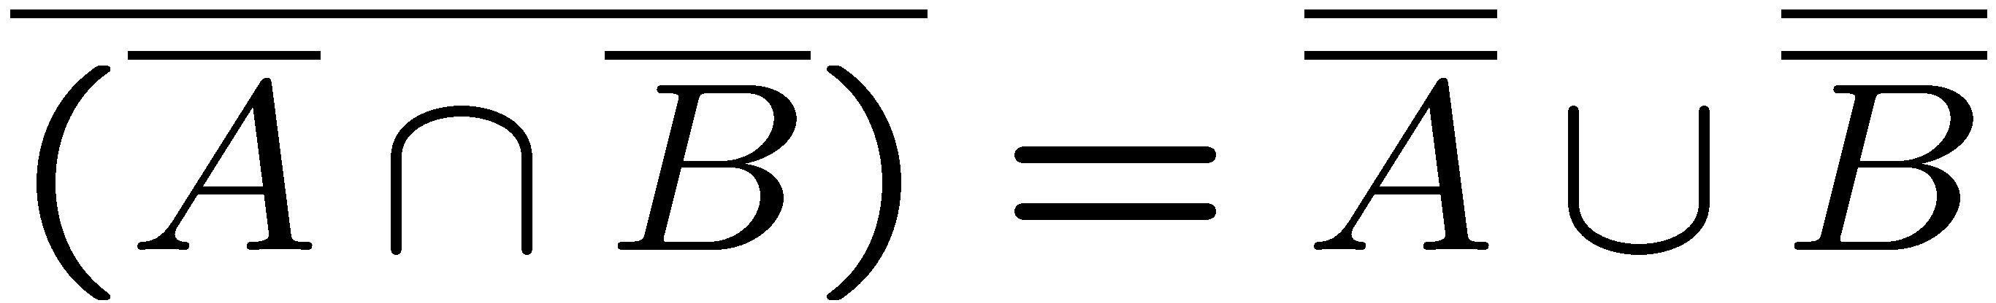

Algebraic Proof
Sometimes when we know some rules, we can use them to prove
new rules without drawing figures.
e.g. we can prove
without drawing figures.
by using DeMorgan’s rule on A and B

Slide 30
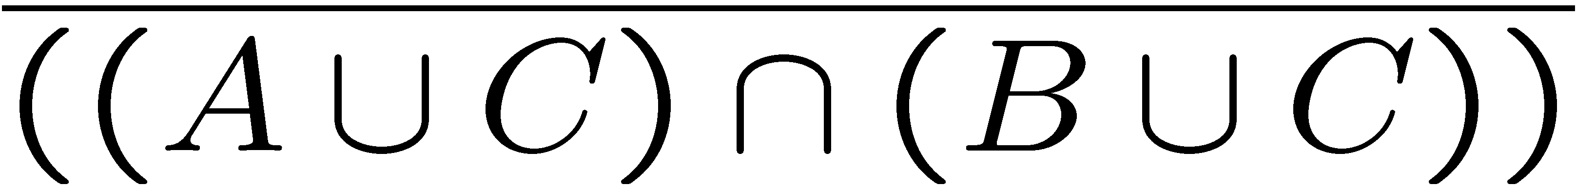





Algebraic Proof
by DeMorgan’s law on A U C and B U C
by DeMorgan’s law on the first half
by DeMorgan’s law on the second half
by distributive law

Slide 31
Exercises

Slide 32
This Lecture
Basic Definitions
Operations on Sets
Set Identities
Russell’s Paradox

Slide 33
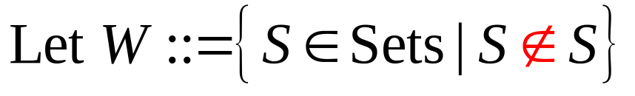
Russell’s Paradox (Optional)
In words, W is the set that contains all the sets that don’t contain themselves.
Is W in W?
If W is in W, then W contains itself.
But W contains only those sets that don’t contain themselves.
So W is not in W.
If W is not in W, then W does not contain itself.
But W contains those sets that don’t contain themselves.
So W is in W.
What’s wrong???

Slide 34
Barber’s Paradox (Optional)
There is a male barber who shaves all those men,
and only those men, who do not shave themselves.
Does the barber shave himself?
Suppose the barber shaves himself.
But the barber only shaves those men who don’t shave themselves.
Since the barber shaves himself, he does not shave himself.
Suppose the barber does not shave himself.
But the barber shaves those men who don’t shave themselves.
Since the barber does not shave himself, he shaves himself.
What’s wrong???

Slide 35
Solution to Russell’s Paradox (Optional)
A man either shaves himself or not shaves himself.
A barber neither shaves himself nor not shaves himself.
Perhaps such a barber does not exist?
Actually that’s the way out of this paradox.
Going back to the barber’s paradox,
we conclude that W cannot be a set,
because every set is either contains itself or not,
but either case cannot happen for W.
This paradox tells us that not everything we define is a set.
Later on mathematicians define sets more carefully,
e.g. using sets that we already know.

Slide 36
Halting Problem (Optional)
Now we mention one of the most famous problems in computer science.
The halting problem: Can we write a program which detects infinite loop?
We want a program H that given any program P and input I:
H(P,I) returns “halt” if P will terminate given input I;
H(P,I) returns “loop forever” if P will not terminate given input I.
And H itself must terminate in finite time.
The halting problem: Does such a program H exist?
NO!
The reasoning used in solving the halting problem is very similar
to that of Russell’s paradox, if you’re interested please see
Chapter 5.4 of the textbook.

Slide 37
Summary
Recall what we have covered so far.
Basic Definitions (defining sets, membership, subsets, size)
Operations on Sets (intersection, union, difference, complement,
        partition, power set, Cartesian product)
Set Identities (distributive law, DeMorgan’s law,
checking set identities – proof & disproof, algebraic)
We won’t ask difficult questions about sets,
but later on sets will be in our language in this course,
so make sure that you remember the basic definitions and notation.

